Slide 1
CLOTH MODELING
Instituto Politécnico Nacional Escuela Superior de Cómputo Computer Graphics Presentation : Cloth Modeling Malagón Baeza Alan Adrian Rosas Trigueros Jorge Luis 12/06/2023
ALAN ADRIAN MALAGÓN BAEZA

Slide 2
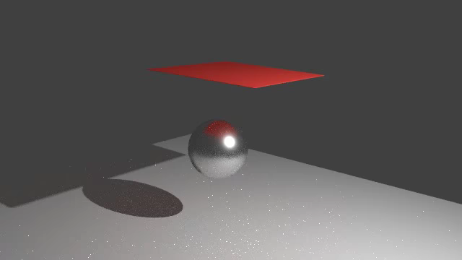
CLOTH MODELING
Simulating cloth within a computer program
Geometric
Physical
Particle/energy
Notes:
Cloth modeling is the term used for simulating cloth within a computer program, usually in the context of 3D computer graphics. The main approaches used for this may be classified into three basic types: geometric, physical, and particle/energy.

Slide 3
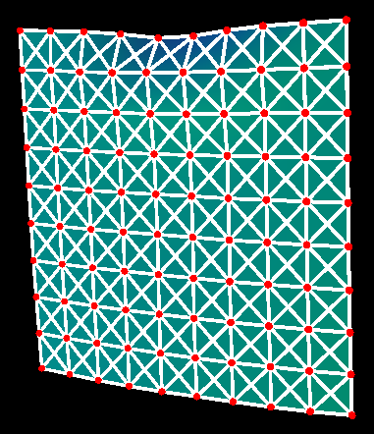

Background
Particles -> Mesh
Newtonian Physics
Notes:
Most models of cloth are based on "particles" of mass connected in some manner of mesh. Newtonian Physics is used to model each particle through the use of a "black box" called a physics engine.
This involves using the basic law of motion (Newton's Second Law): F=ma
In all of these models, the goal is to find the position and shape of a piece of fabric using this basic equation and several other methods.

Slide 4
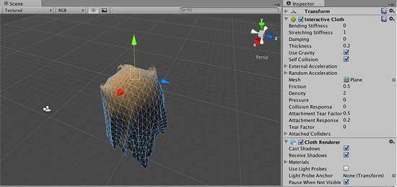

Cloth in Unity

Slide 5
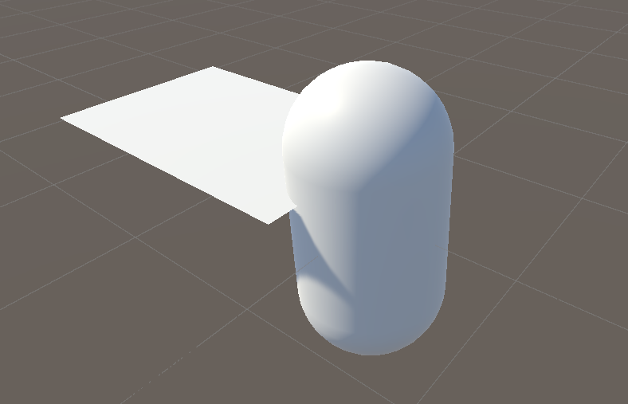
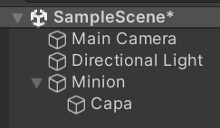

Slide 6
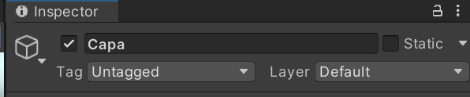
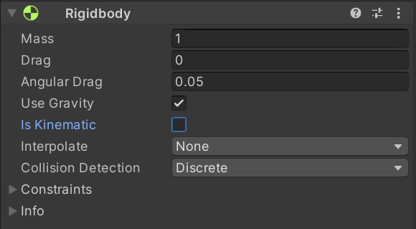
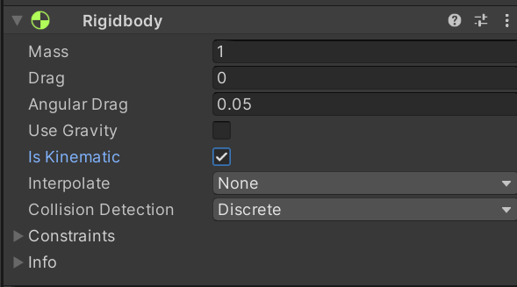

Slide 7
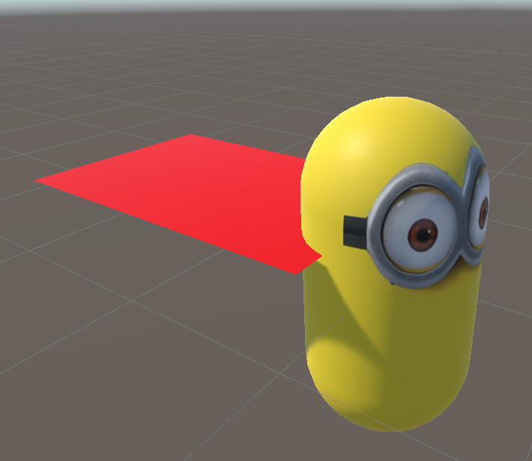
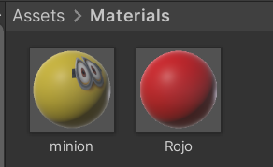

Slide 8
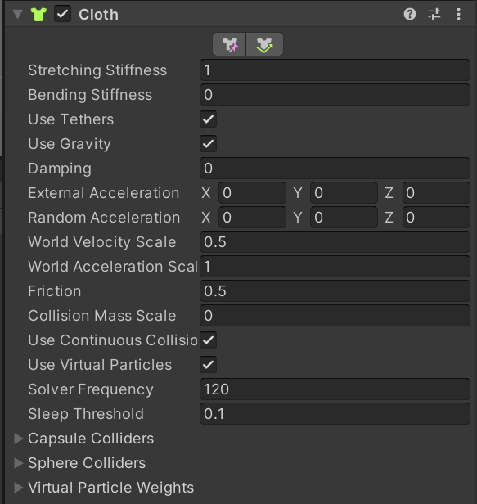

Slide 9

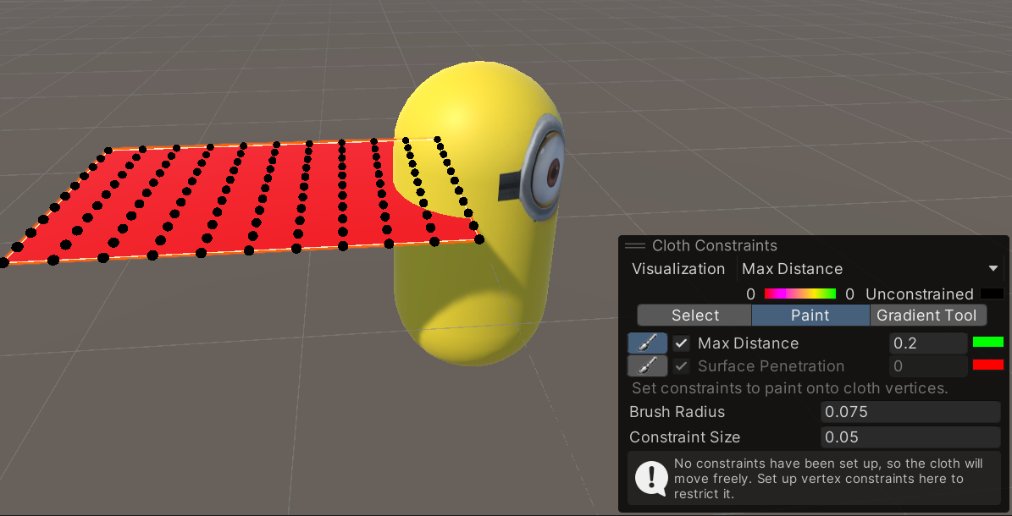
Edit cloth constraints

Slide 10
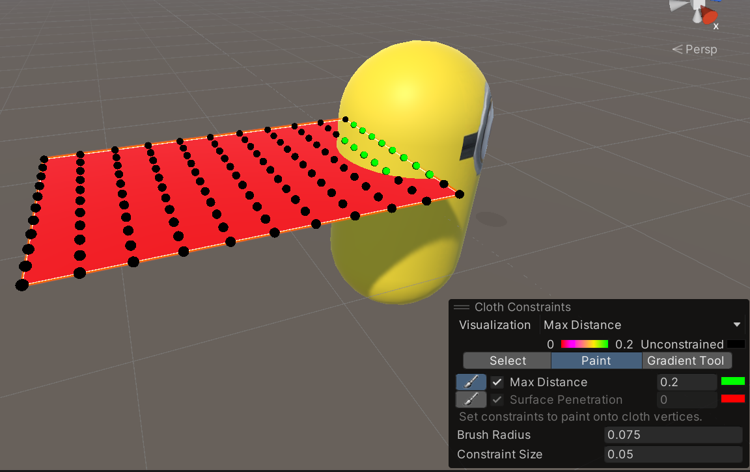

Slide 11
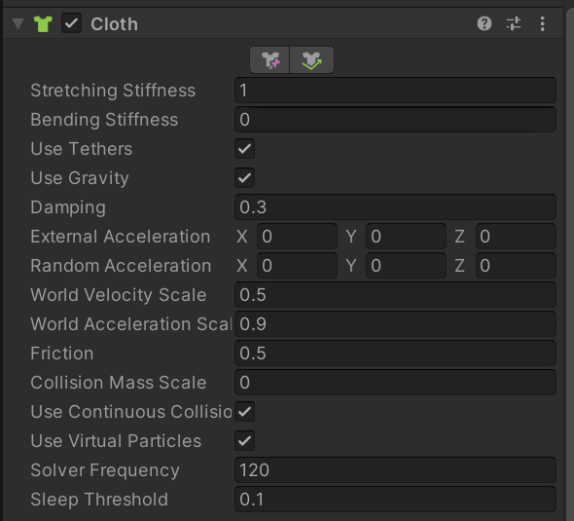
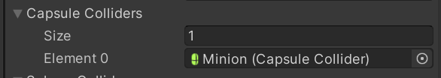

Slide 12
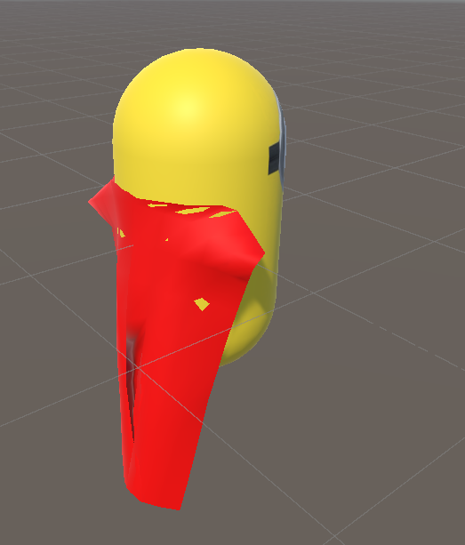
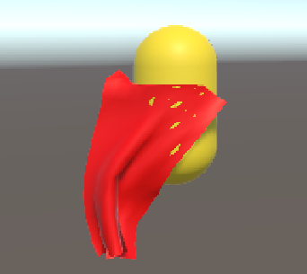
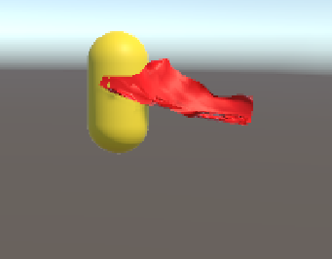

Slide 13
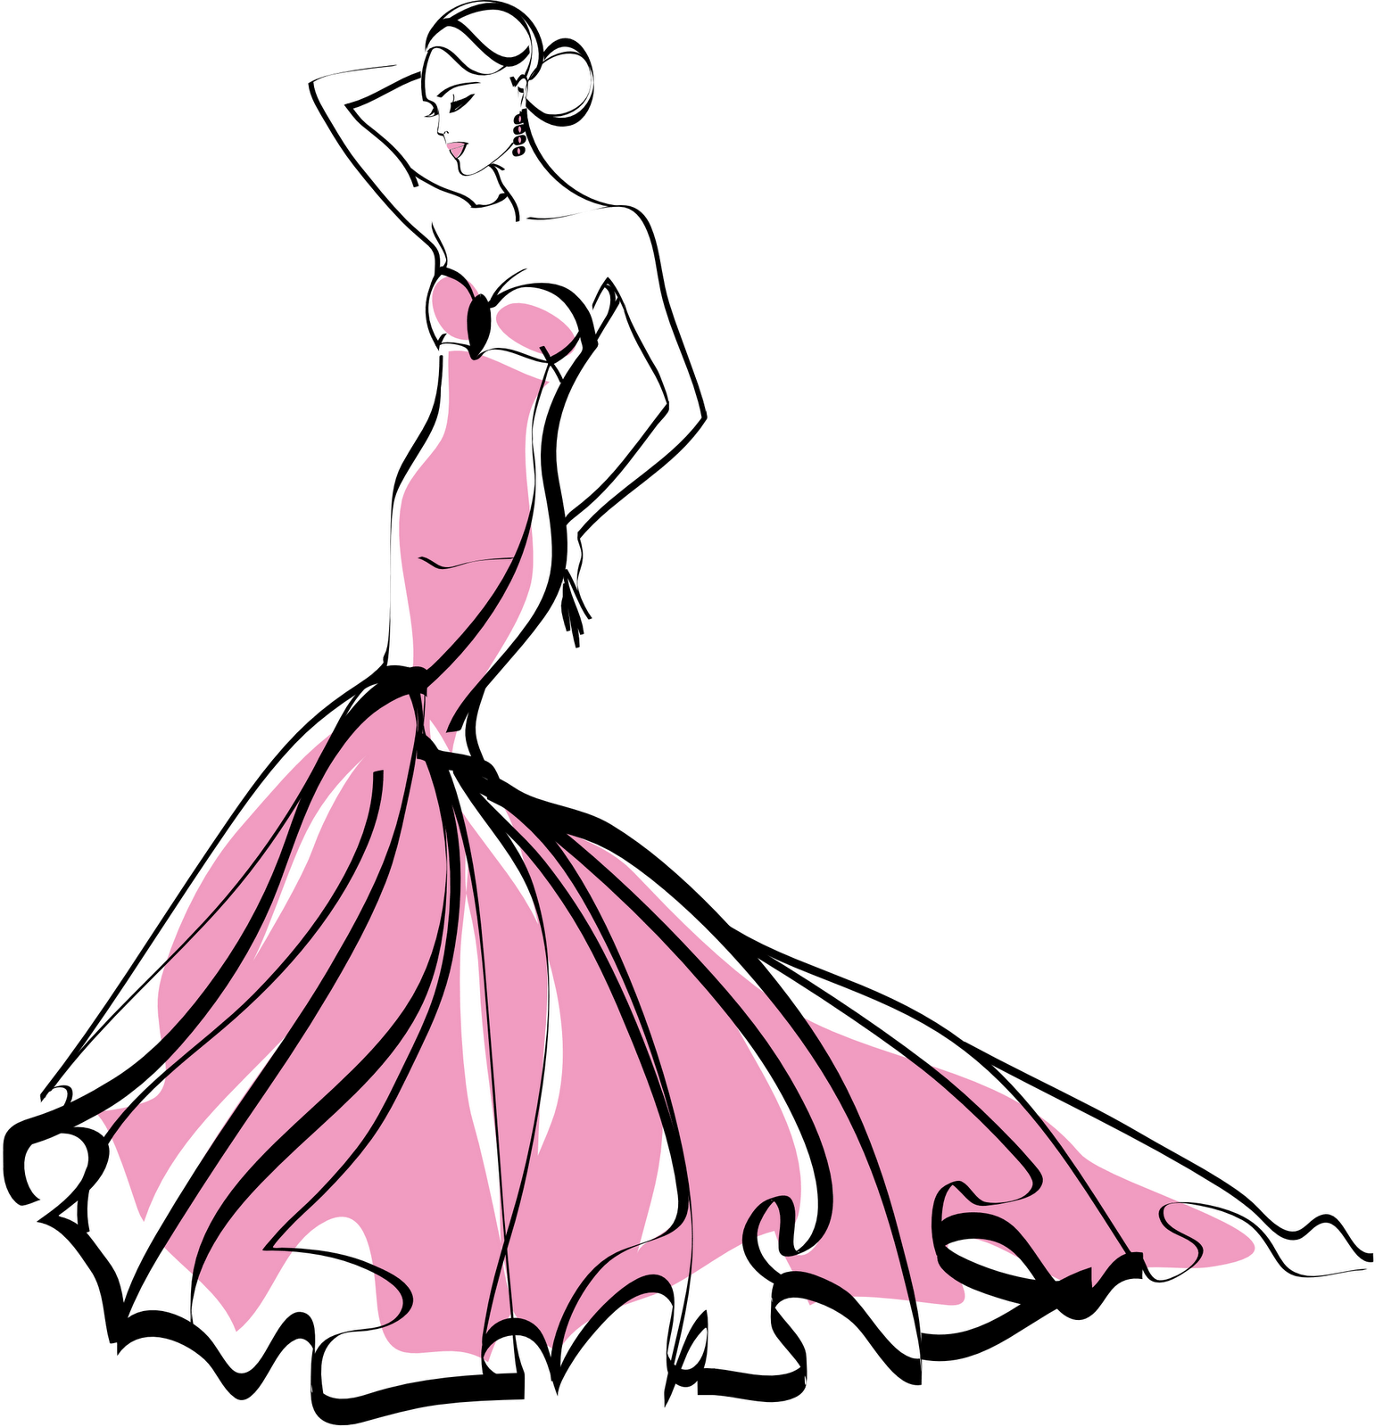

Applications
Notes:
To date, making the clothing of a digital character automatically fold in a natural way remains a challenge for many animators
In addition to their use in film, advertising and other modes of public display, computer generated images of clothing are now routinely used by top fashion design firms.

Slide 14
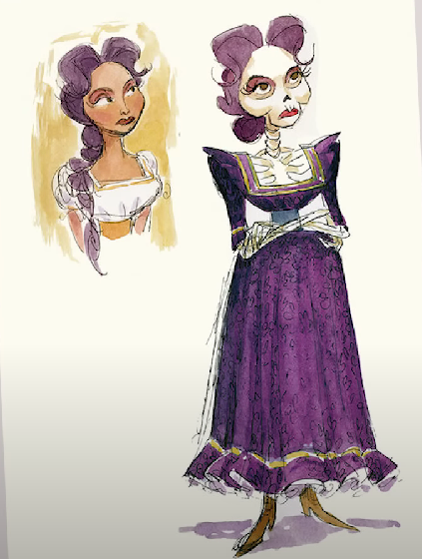
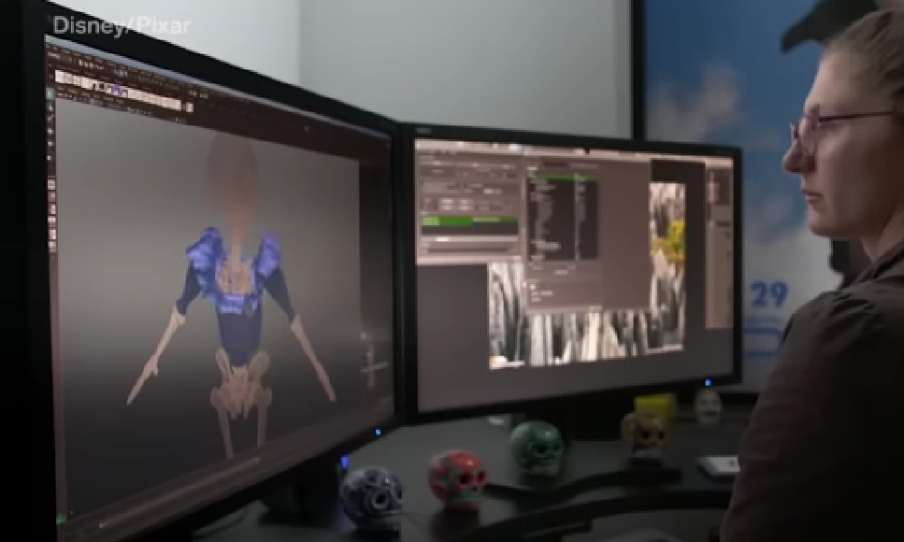
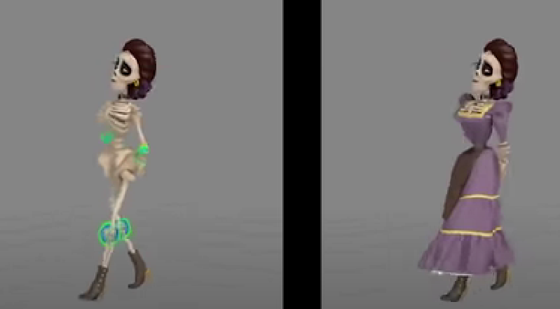
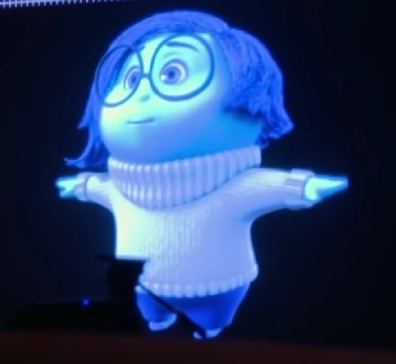
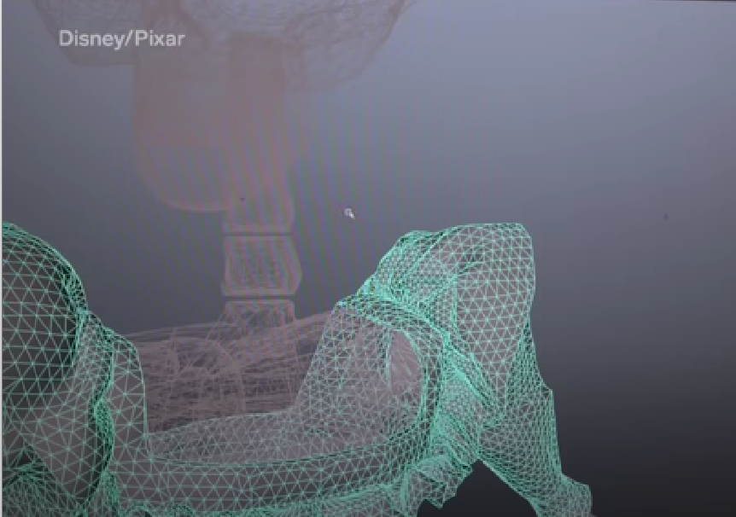
Films
Notes:
First character’s wardrobe is designed.
Once its done, all the art reference gets handed over to pixar’s character tailoring artist who basically act as digital tailors for the film.
Its their job to worry about every single piece of clothing you see in a movie
Their first task is to bring the clothes into virtual form by modeling them in the computer ,they build a 3d shape or model of each garment ,then fit it on the character model also known as the skin
As part of the fitting process they’ll take the character through a series of animated poses to see how the clothing fits

Slide 15
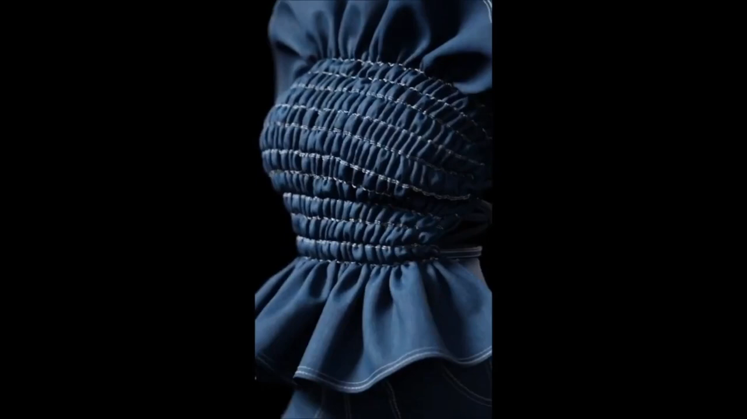


Anifa Mvuemba
Notes:
When Hanifa brand runway was cancelled at a New York Fashion Week because of COVID
,her founder Anifa Mvuemba decided to turn it into a virtual one and stream it over Instagram Live,
transforming each garment in a 3D image, and fitting and moving them onto the body of avatars

Slide 16

THANKS! Q&A

Slide 17
RESOURCES
Davis, M. (2002). Cloth simulation. Retrieved from https://web.archive.org/web/20070211131507/http://davis.wpi.edu/~matt/courses/cloth/
O'Connor, J. J., & Robertson, E. F. (2010). André Weil. Retrieved from https://mathshistory.st-andrews.ac.uk/Biographies/Weil/
Wikipedia contributors. (2023, April 25). Computer-generated imagery. In Wikipedia. Retrieved May 1, 2023, from https://en.wikipedia.org/wiki/Computer-generated_imagery
Wikipedia contributors. (2022, November 27). Cloth modeling. In Wikipedia. Retrieved May 1, 2023, from https://en.wikipedia.org/wiki/Cloth_modeling
Wikipedia contributors. (2023, March 6). Hyperbolic cosine. In Wikipedia. Retrieved May 1, 2023, from https://en.wikipedia.org/wiki/Hyperbolic_cosine
CGI Interactive. (2018, February 7). Cloth Simulation Tutorial with Blender [Video file]. Retrieved from https://www.youtube.com/watch?v=BKPiqUryHfs
Zaikman, D. (2020, November 12). Physics of Cloth Animation Tutorial [Video file]. Retrieved from https://www.youtube.com/watch?v=LZ1h0Zj5gAs

